Slide 1
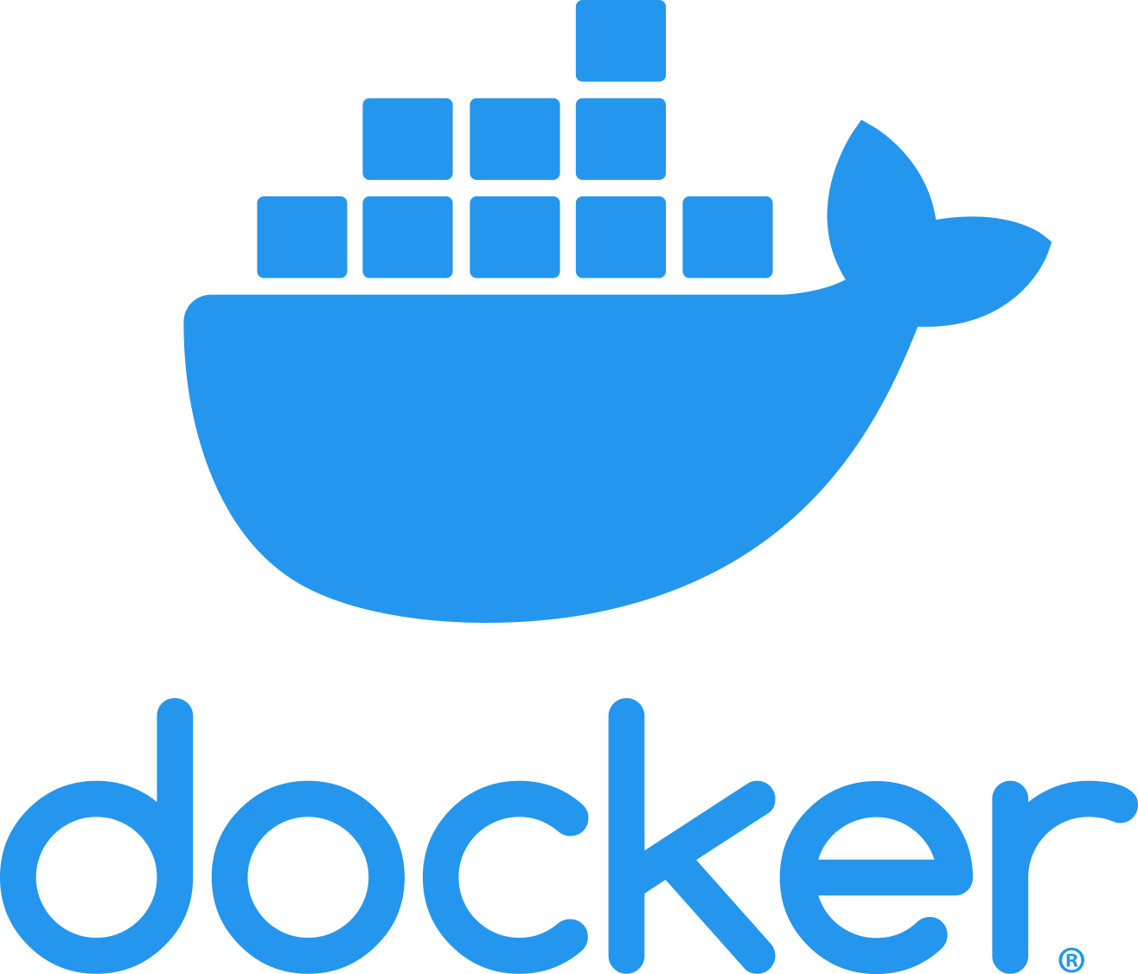

Triển khai Spring Boot lên Docker
www.jmaster.io/course/microservices-with-spring-cloud

